Slide 1
Transition Performance of Transistor
Soft-switching leads to
Less Oscillation -> Low EMI
Low Overshoot Level
Higher Switching Losses

Slide 2
Output Voltage Ripple for Different Cases
Interleaving decreases output voltage ripple significantly and it doubles the ripple frequency
Output voltage ripple is higher for soft-switching due to high inductor current ripple

Slide 3
Output Voltage Ripple for Different Cases
Interleaving is much more important for soft-switched ZVRT buck converter application
Inductor current ripples for hard and soft switching cases

Slide 4
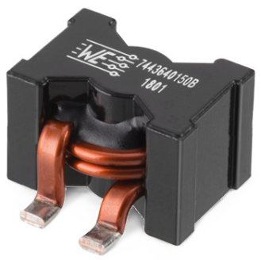
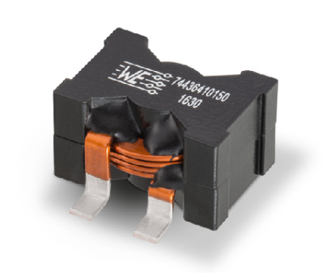
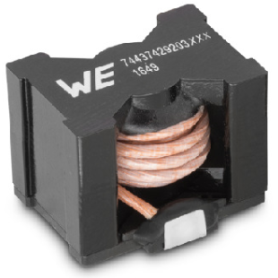
Verification of Magnetic Design
What are the challenges?
Even though DC resistance of inductor is low, AC resistance is an important concern for such high frequency & high ripple current flow.
Skin depth & proximity effect should be analyzed.
The round-wire inductors are not suitable due to their thickness.
Litz wire inductors are the best options but somehow their saturation
current limit is low.
Therefore, flat-wire inductors are suitable for
our application.

Slide 5
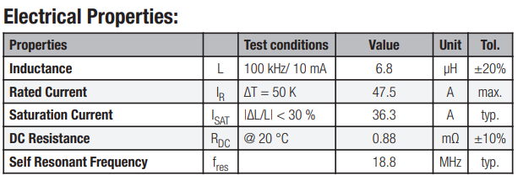
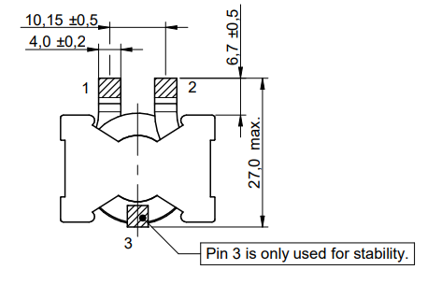
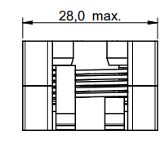
Verification of Magnetic Design
Selected Inductor Parameters (7443640680B)
382 kHz switching frequency, so lets round it to 500 kHz to decrease the ripple
2W loss for 50K temp. increase
No saturation risk
Very low DC resistance

Slide 6
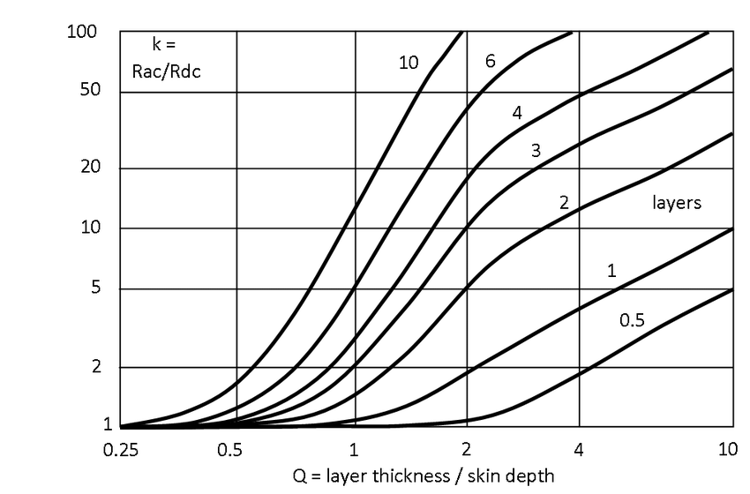
Verification of Magnetic Design
Selected Inductor Parameters
δ = 92.2 μm & 700 μm pad thickness -> Q = 7.6
Rac ≈ 8 * Rdc -> Rac = 7.04 mohm
0.61 W Inductor Winding Loss

Slide 7
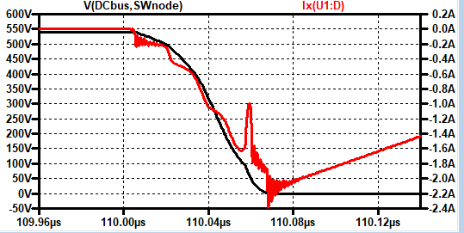
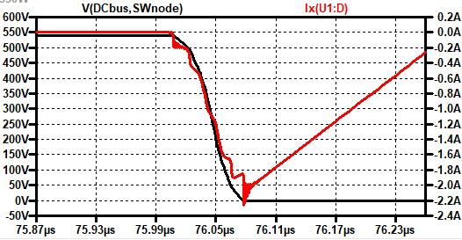
Loss Analysis
 | Results for 500 kHz (Ron = 10R, Roff = 2R) | Results for 500 kHz (Ron = 20R, Roff = 5R) | Results for 500 kHz (Ron = 20R, Roff = 2R)
I(C) | 5.718 Arms @1MHz | 5.718 Arms @1MHz | 5.718 Arms @1MHz
I(L) | 13.26 Arms @500 kHz | 13.26 Arms @500 kHz | 13.26 Arms @500 kHz
Ipeak(L) | 25 A, -4.5 A | 25 A, -4.5 A | 25 A, -4.5 A
Ploss(top switch) | 4.923 W | 4.87 W | 4.6 W
Ploss(bot switch) | 3.297 W | 3.653 W | 3.76 W
Ploss(total) | 32.9 W | 34.1 W | 33.4 W
K | 3 | 3 | 3
Soft Switching gets distorted

Slide 8
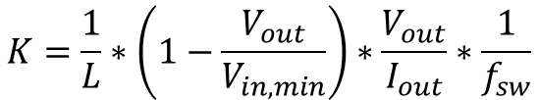
Loss Analysis
 | Results for 20A Output Current | Results for 2A Output Current
I(C) | 5.718 Arms @1MHz | 5.718 Arms @1MHz
I(L) | 13.26 Arms @500 kHz | 8.308 Arms @500 kHz
Ipeak(L) | 25 A, -4.5 A | 15 A, -13A
Ploss(top switch) | 4.6 W | 2.58 W
Ploss(bot switch) | 3.76 W | 1.44 W
Ploss(total) | 33.4 W | 16.08 W
K | 3 | 30
Soft-switching is still maintained
The ripple current still has the same peak-to-peak levels
Inductor & capacitor losses are similar
Unefficient power transition for low output current
$$K=\frac{1}{L}∗\left(1−\frac{V_{out}}{V_{in,min}}\right)∗\frac{V_{out}}{I_{out}}∗\frac{1}{f_{sw}}$$

Slide 9
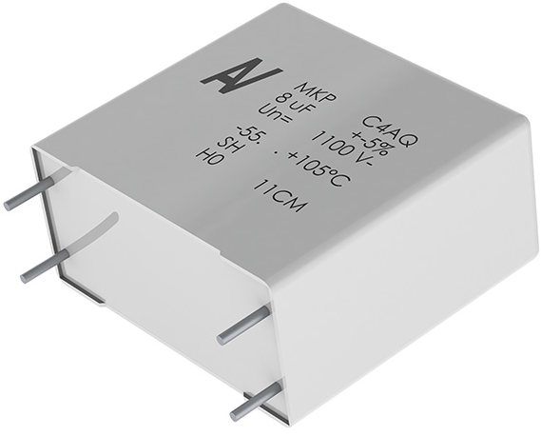
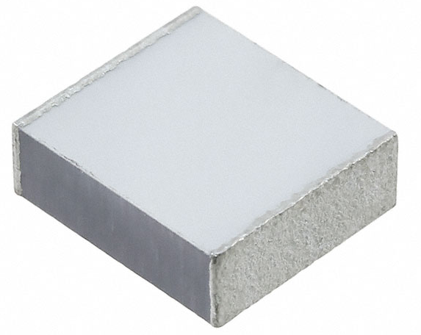
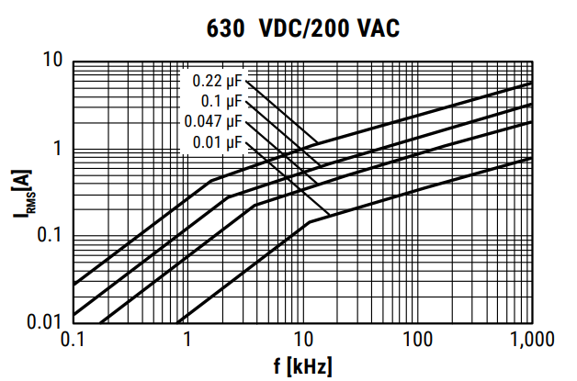
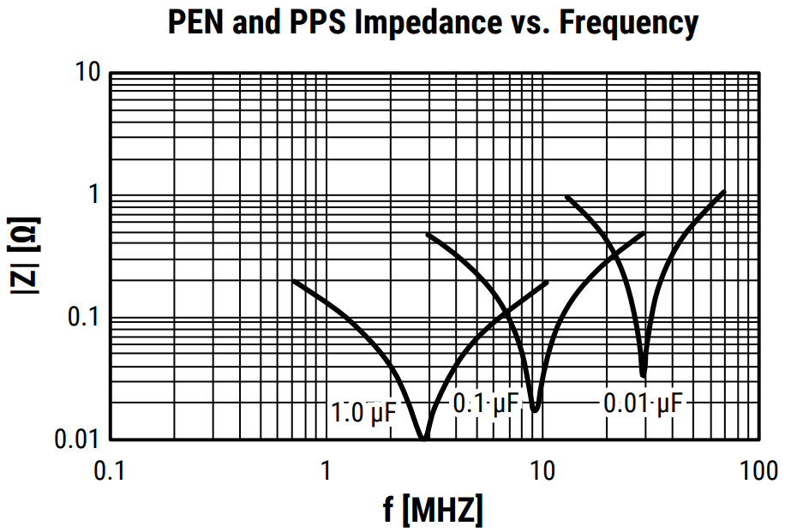
Capacitor Selection
The capacitor selected for 200 kHz ripple frequency cannot be used at 1 MHz because it turns into an inductor.
Almost all of the bulky film capacitors are not able to support 1 MHz frequency ripple.
Chip film capacitor needs to be used to filter output current.
6054 Package SMD component
(LDEPH3220KA5N00)
It can filter 6Arms @ 1MHz

